Slide 1
Evaluation Exercise: GSOC ATLAS Autoencoders
Jake Watson
Google Summer of Code 2021 with CERN

Slide 2
ATLAS
The ATLAS experiment records billions of particles every second, many of these produced by jets.
Jets are showers of particles produced by collisions between high-energy protons in the beam.
To discover new physics from the records of these particles, they must be searched.
Such enormous datasets are difficult to search, so they must be compressed, without losing information.
Autoencoders
An autoencoder is a neural-network that compresses data into a smaller representation. It learns correlations between variables, and uses these to reduce the dimensionality of the data.
The aim of this exercise was to reduce the four-momentum of particles in jets to 3 variables.
Input
Output
Encoder
Decoder
(E, ρ_{T}, Φ, η) (v₁, v₂, v₃)
A typical autoencoder (encoder+decoder) network (Image from docs)

Slide 3
Data Characteristics
The data given in the exercise consists of events, which take up one line in the data file. Each event generates a variable number of particles.
354;monojet_Zp2000.0_DM_50.0;2.44336e-05;732115;1.17245;j,1.06946e+06,751597,0.858186,-1.84217;j,457647,110079,2.10287,2.17501;b,49649.1,30875.2,-1.03189,-1.7992;
The line above shows a sample event from the data. The red section is the label of the event, while the green section is a particle produced in the event, of type b. The particles we are looking for are in blue, with type j. There are four numeric variables for each particle, corresponding to its four-momentum. Preparing the data consists of identifying and extracting the jets and their momenta into one list, then separating them into training and test sets, split 70:30.
Training sample:
E pt eta phi
517 2185710.0 526905.0 -2.100720 0.122373
13134 220475.0 32153.6 -2.612360 0.093524
20934 654473.0 539285.0 0.641511 0.110375
6628 1122510.0 524878.0 1.392520 -2.509970
10598 385025.0 313724.0 0.658764 0.827492
The number of entries in the training data: 15805
Testing sample:
E pt eta phi
2679 123122.0 86671.3 -0.875539 -0.270748
2168 670655.0 616155.0 -0.414518 2.565740
22083 197364.0 35386.3 -2.403340 1.681830
2165 873631.0 448144.0 1.283490 2.072950
12466 682984.0 32830.4 -3.727630 -1.003890
The number of entries in the validation data: 6774

Slide 4
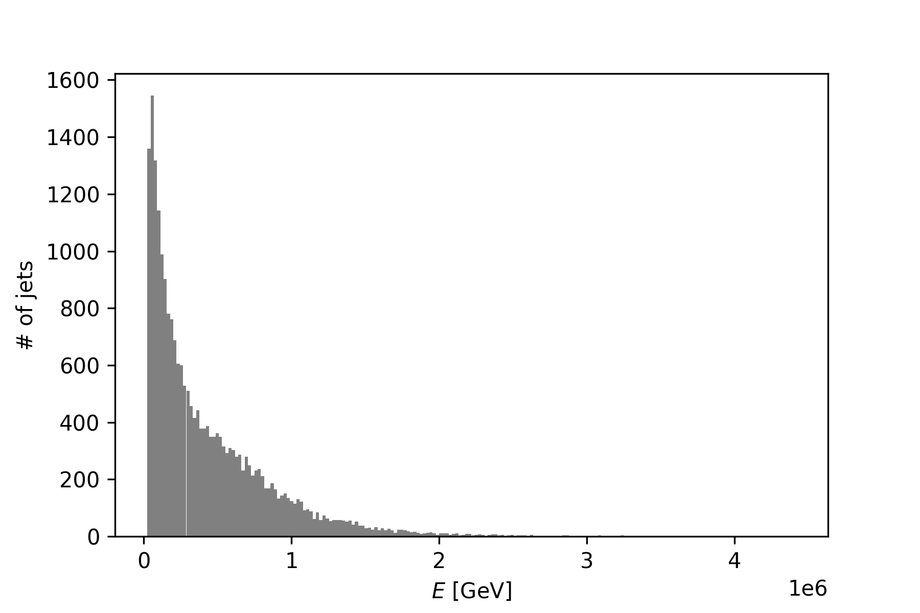
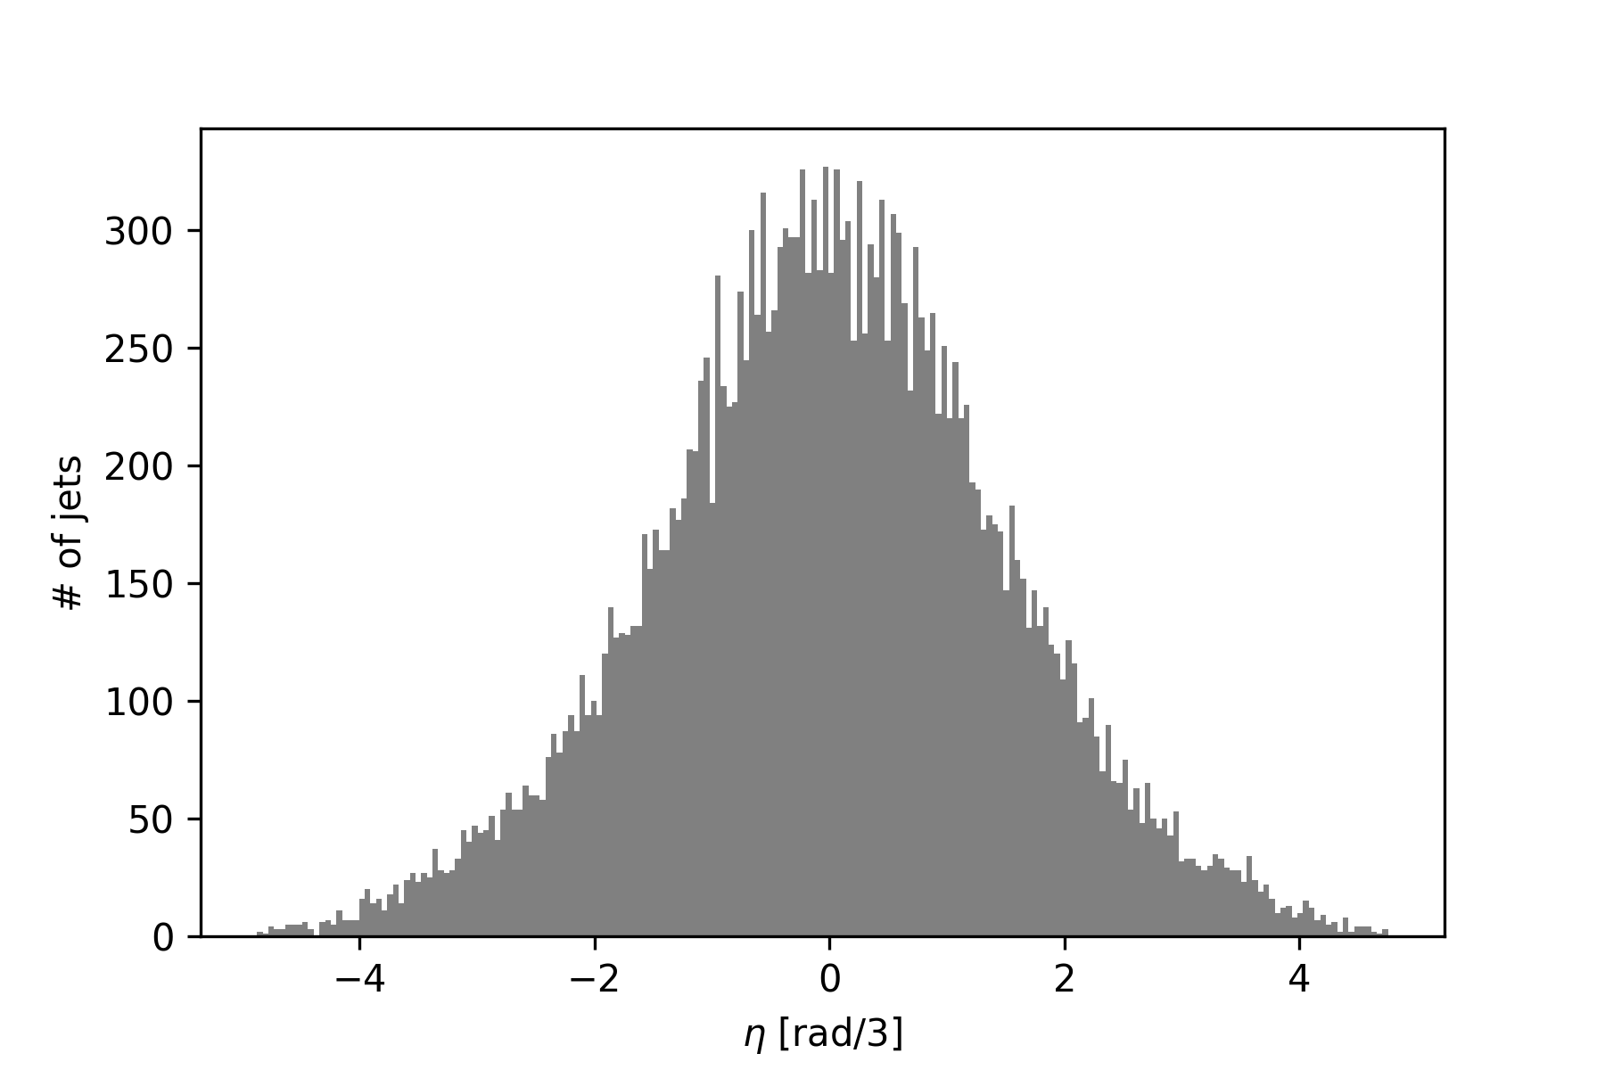
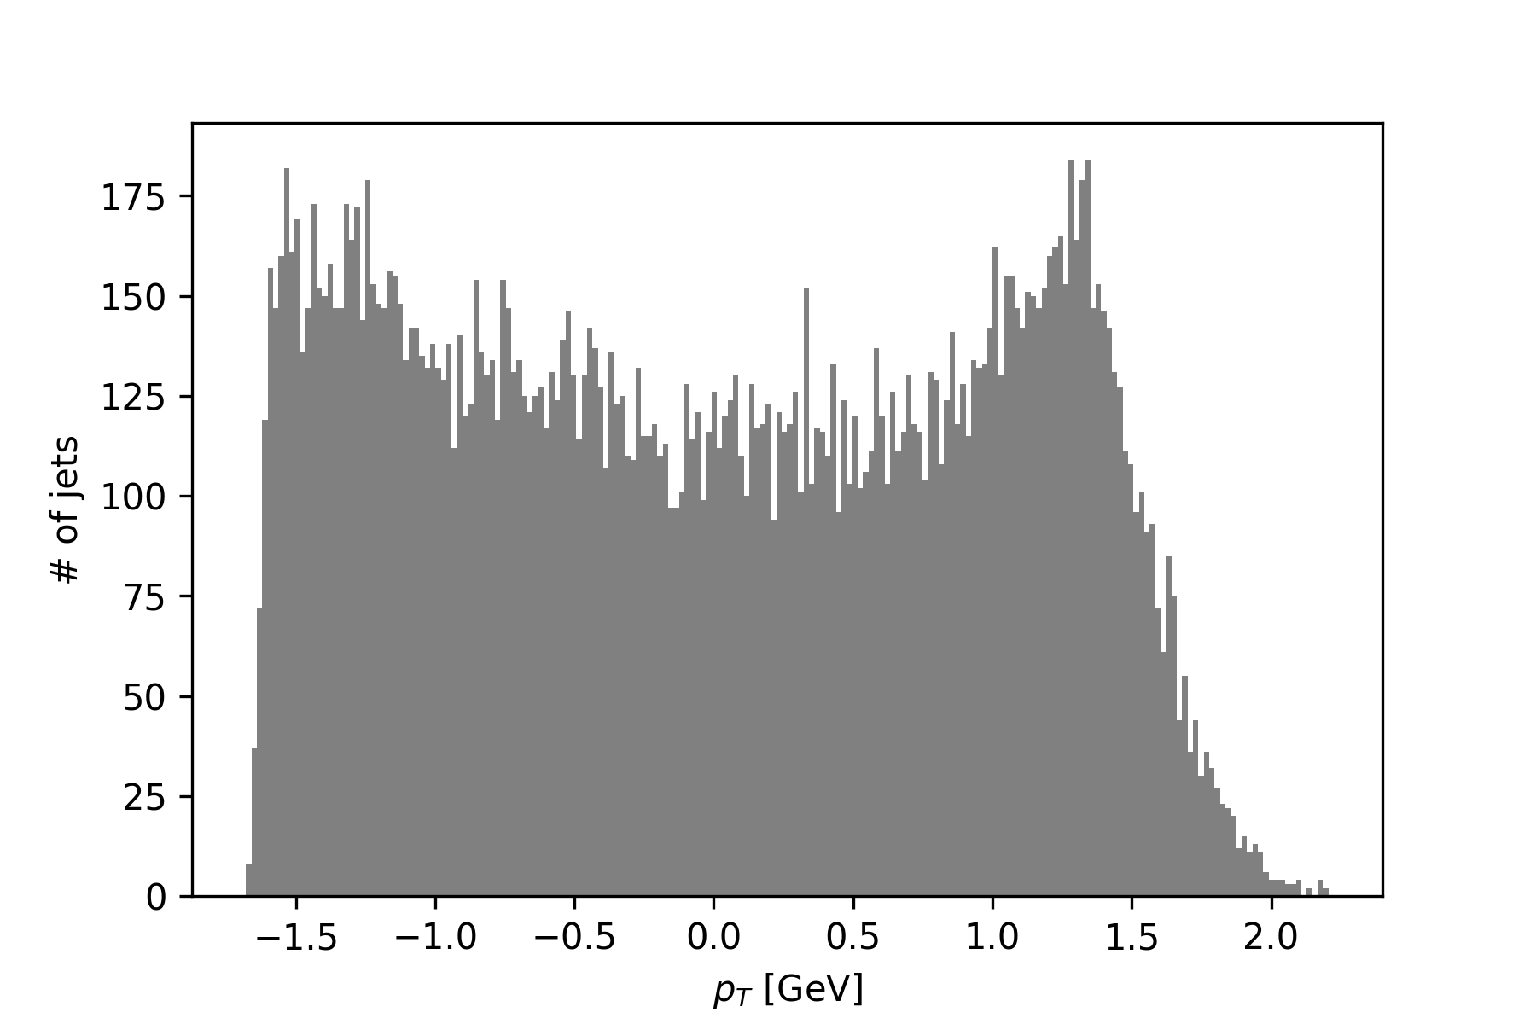
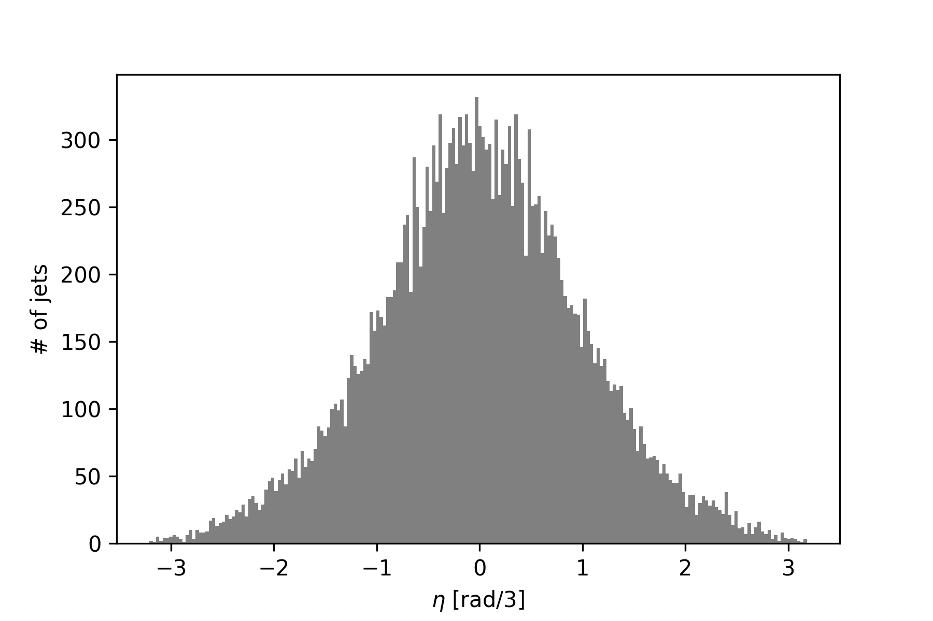
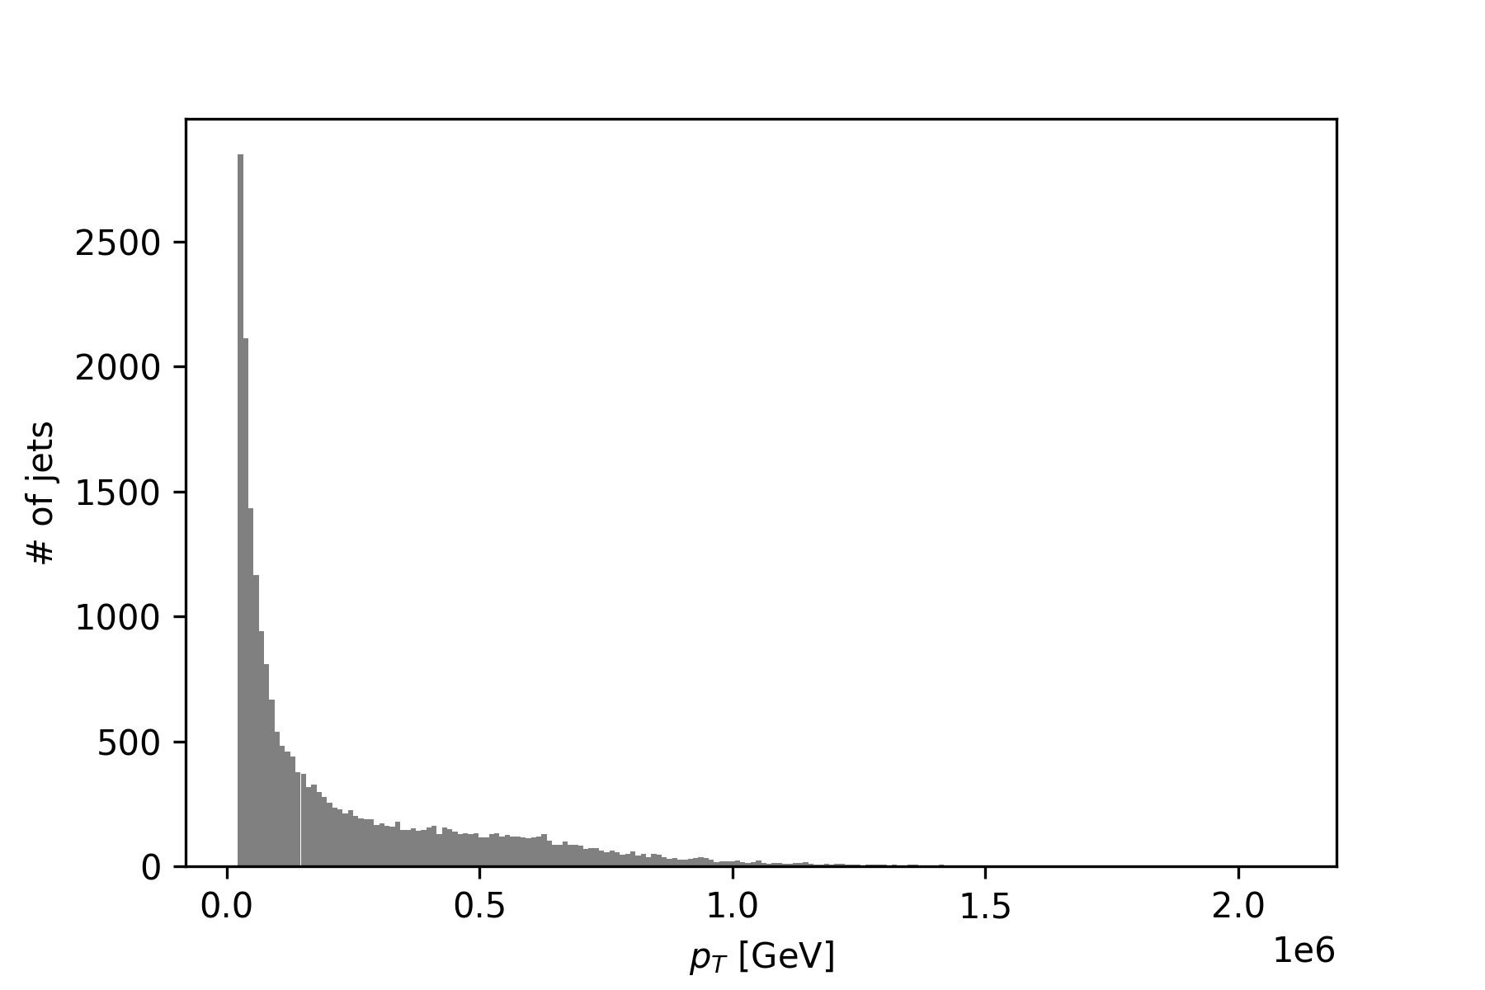
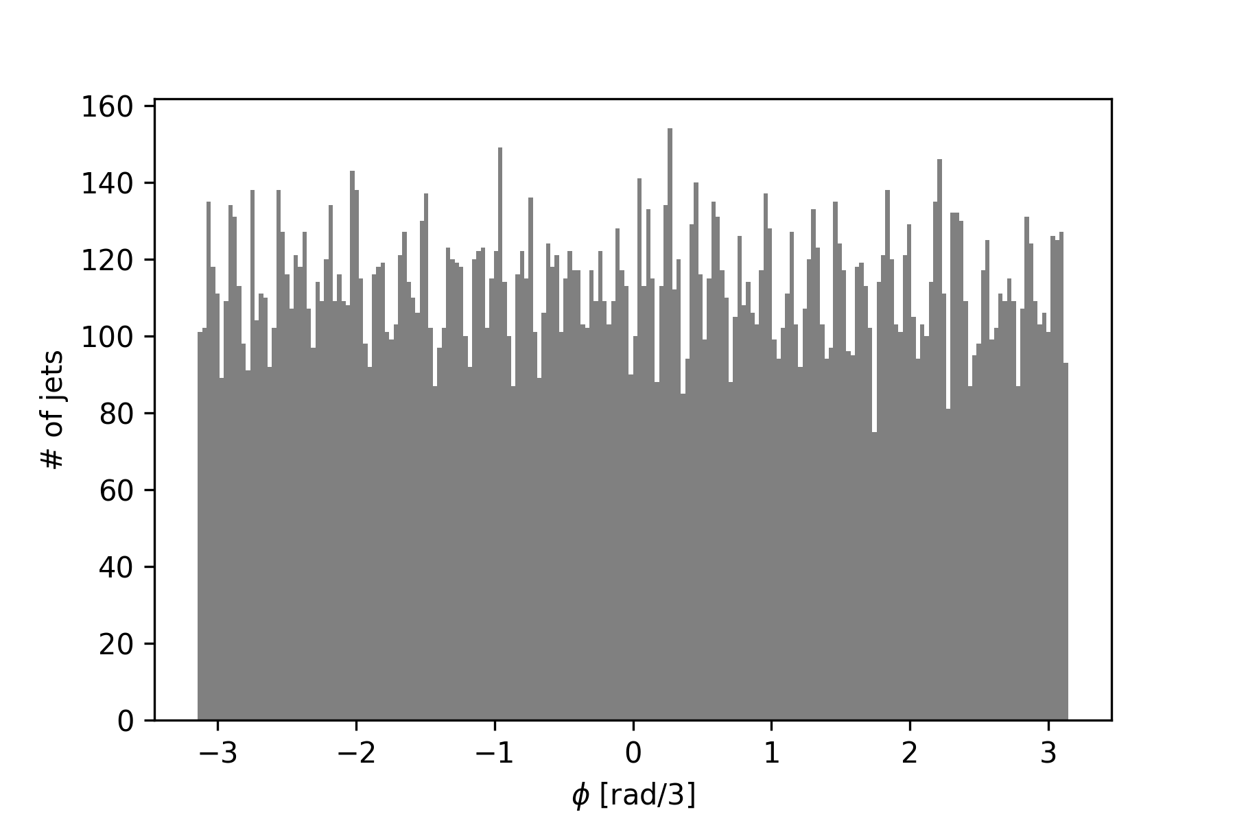
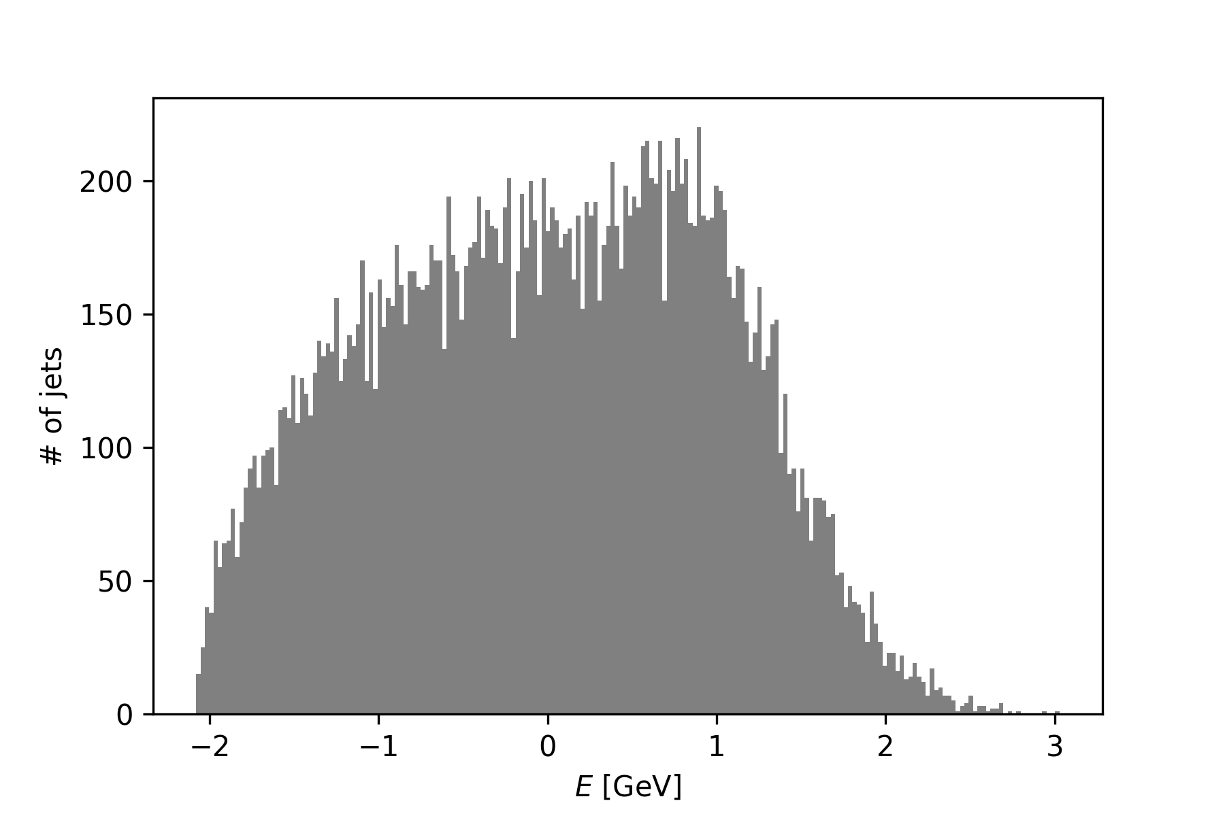
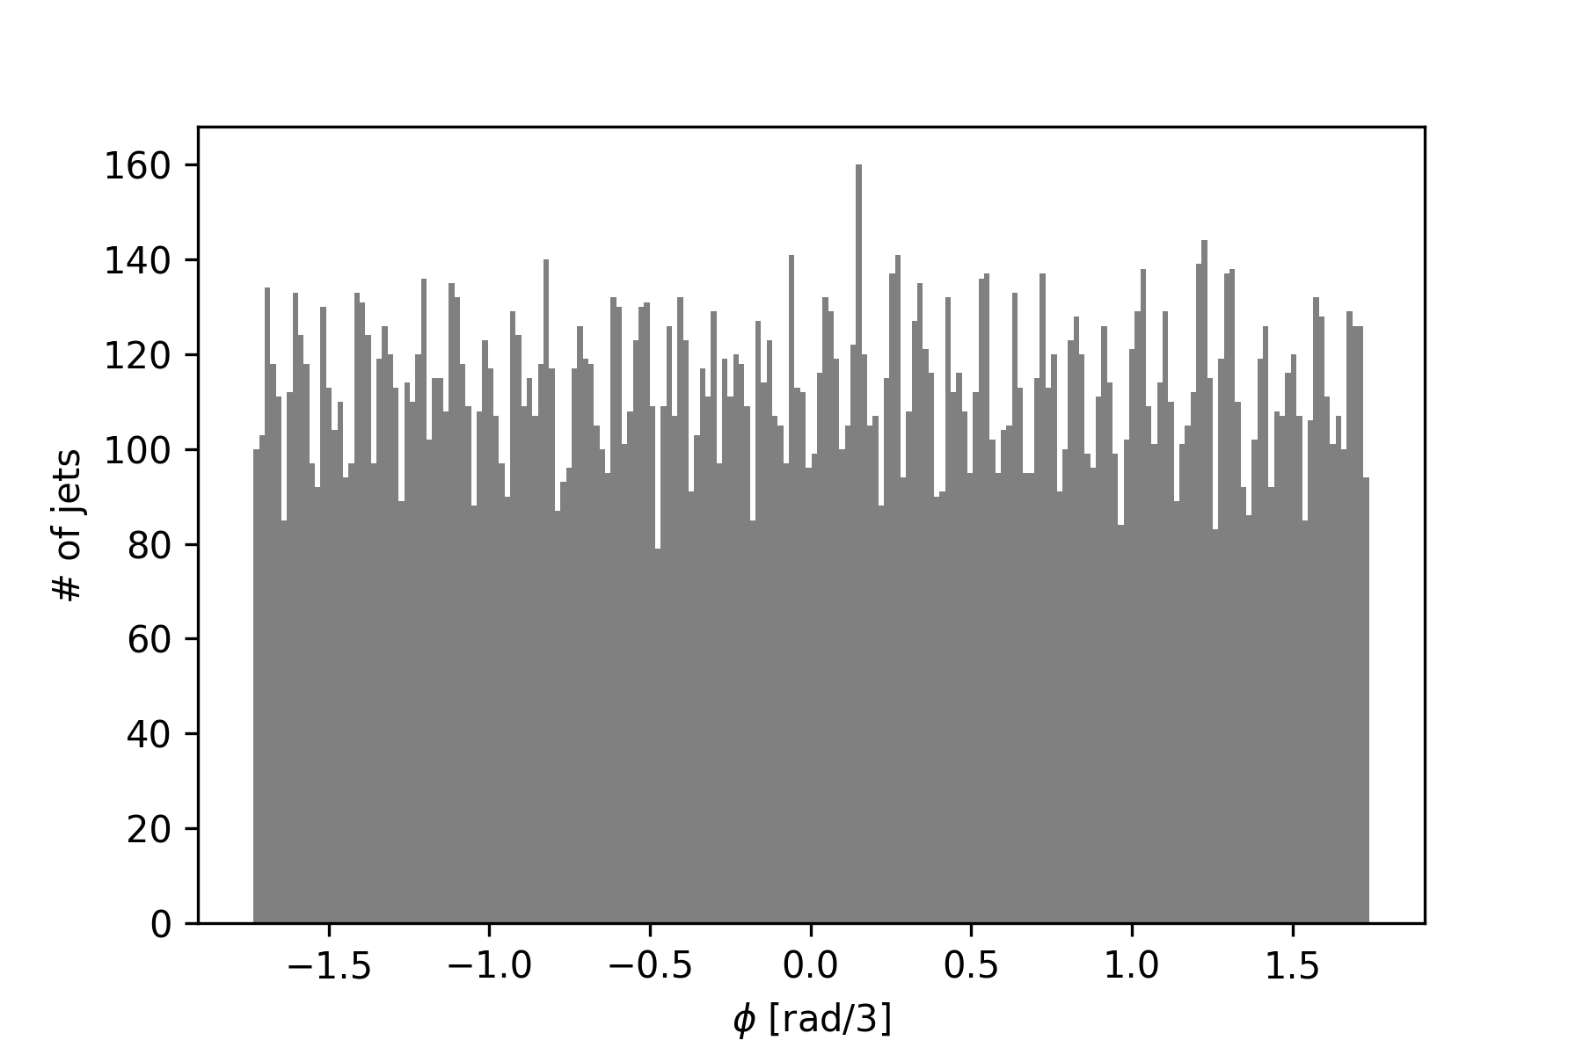
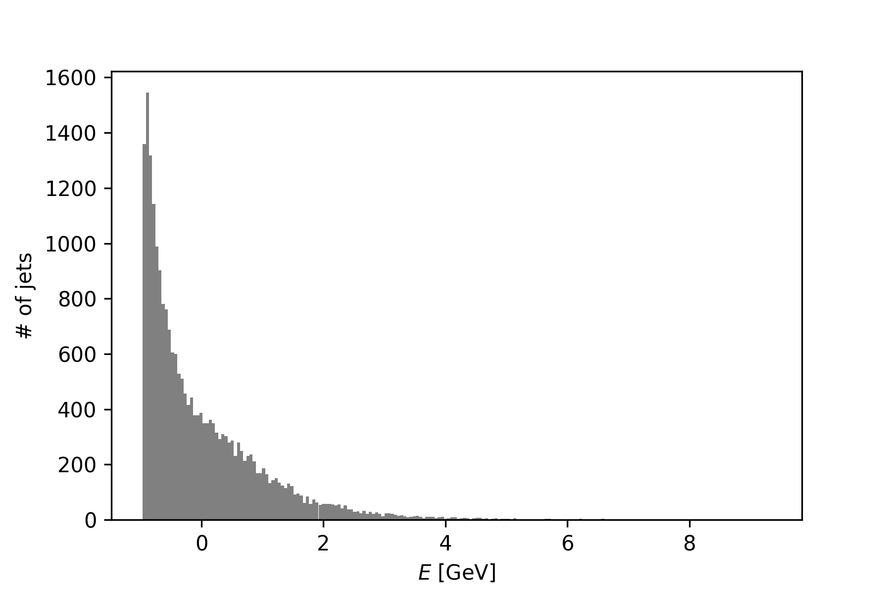

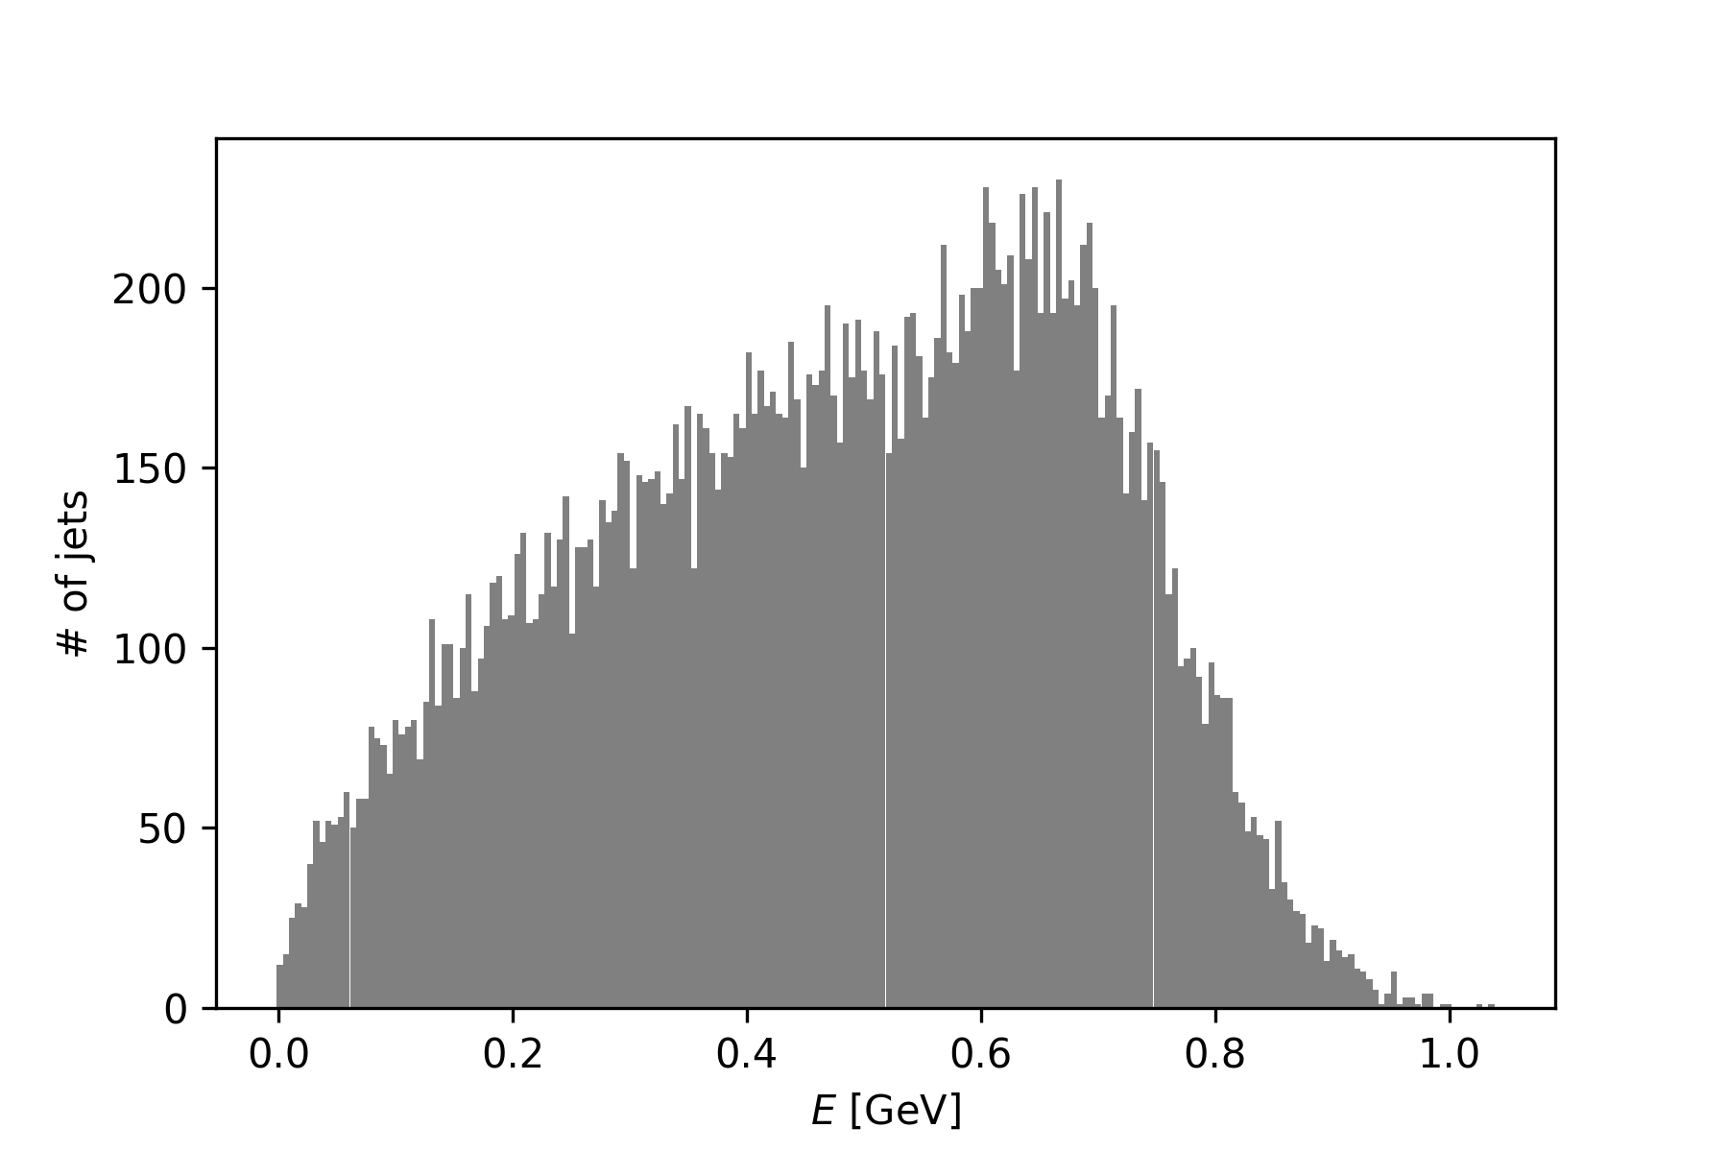
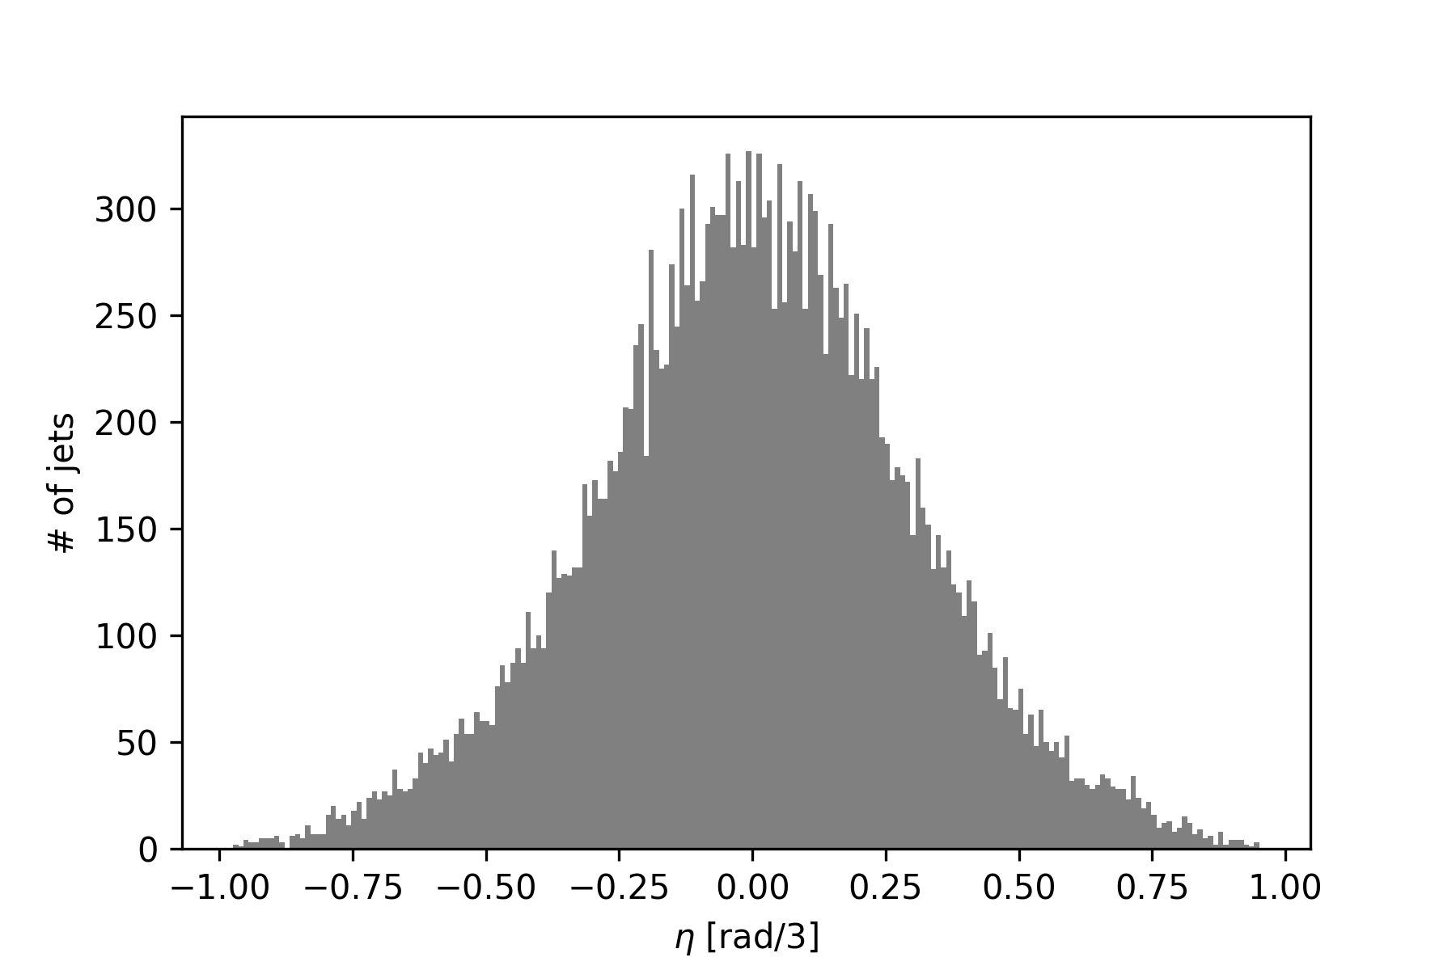
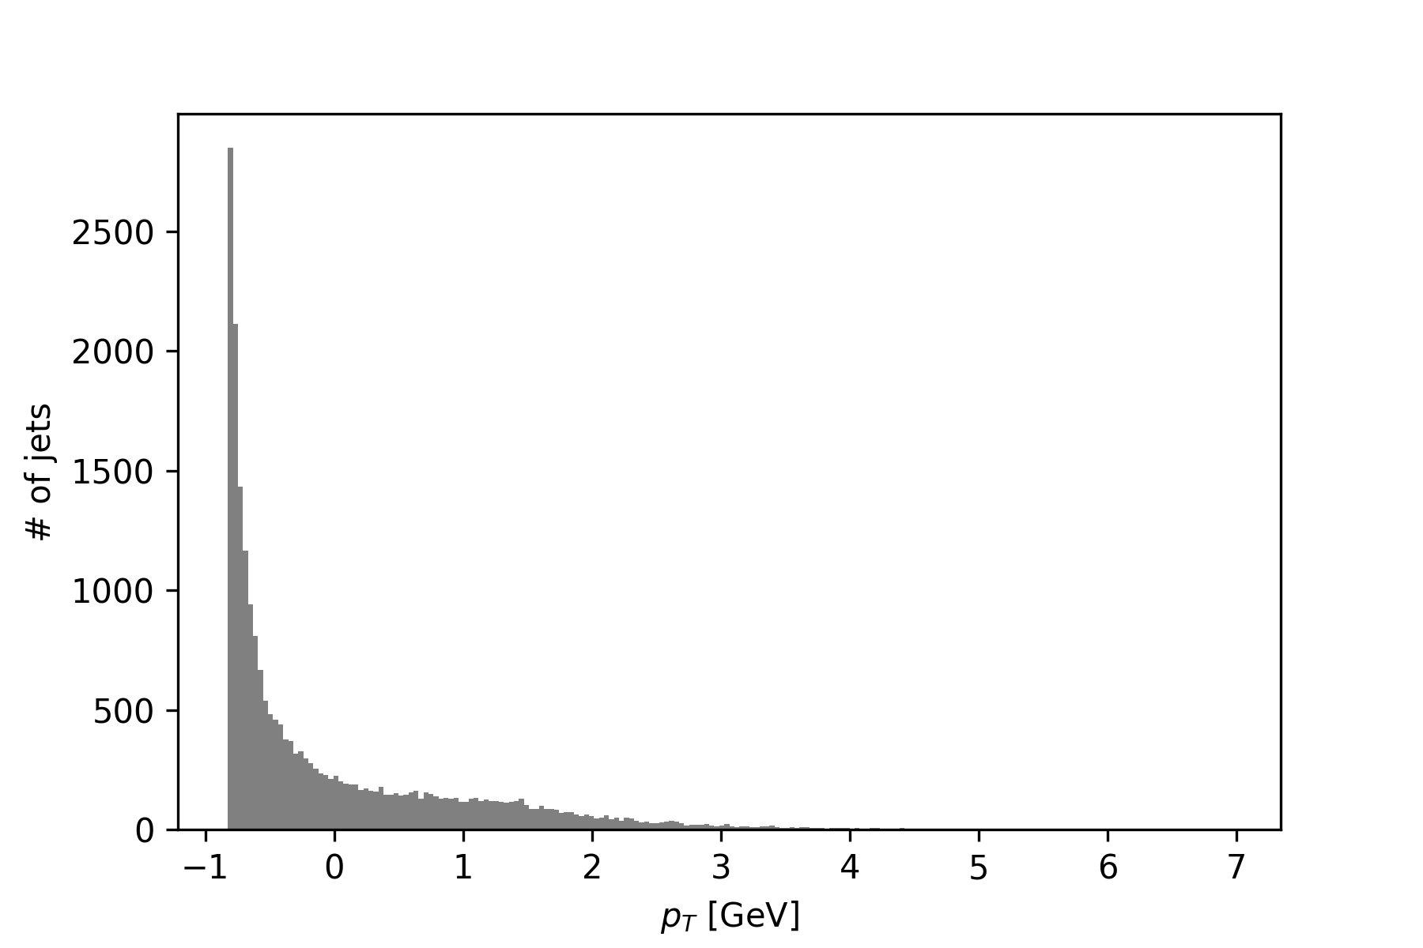
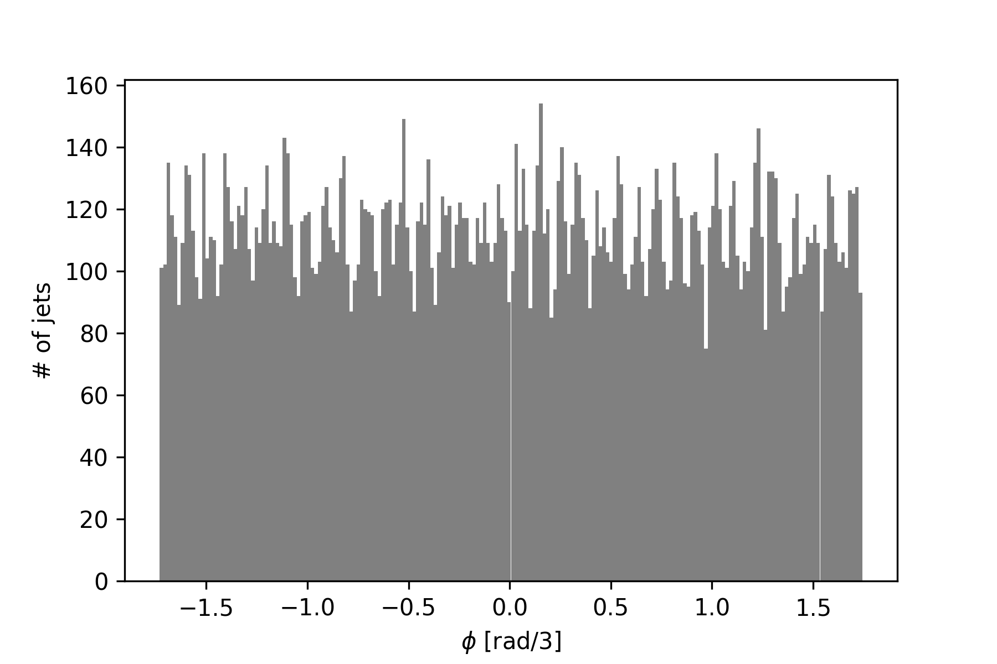
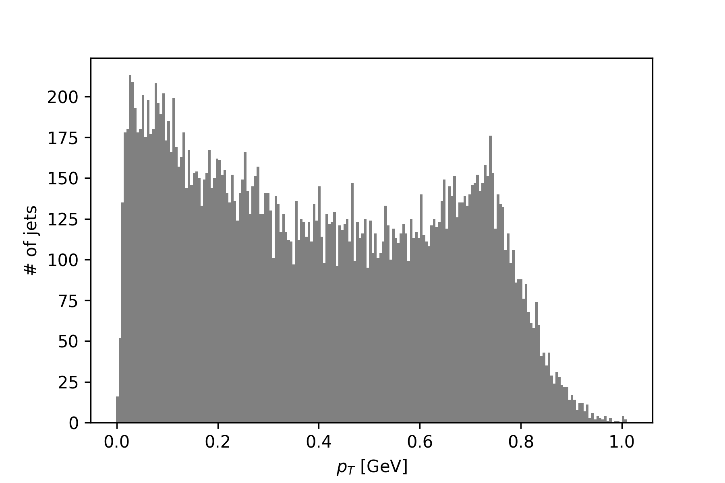

Normalization
Inputs to a neural network must be scaled, especially if they have very different magnitudes. This helps the network to learn the distribution of the inputs, without being dominated by one larger variable. Four scaling methods were tested on the given (tanh, no BN) network:
No scaling: no changes to the raw data.
Eval score: 1.242e11
Standard scaling: centering by subtracting the mean, and scaling by dividing by the standard deviation.
Eval Score: 5.802e-05
Power scaling: using the non-linear Yeo-Johnson transform to map the data to a Gaussian.
Eval Score: 1.878e-04
Custom scaling: manually normalizing each variable individually. The E and ρ_{T} were normalized by taking logarithms, while Φ and η used a division by their maximum difference.
Eval Score: 2.504e-06
No scaling
Power scaling
Standard scaling
Custom scaling

Slide 5
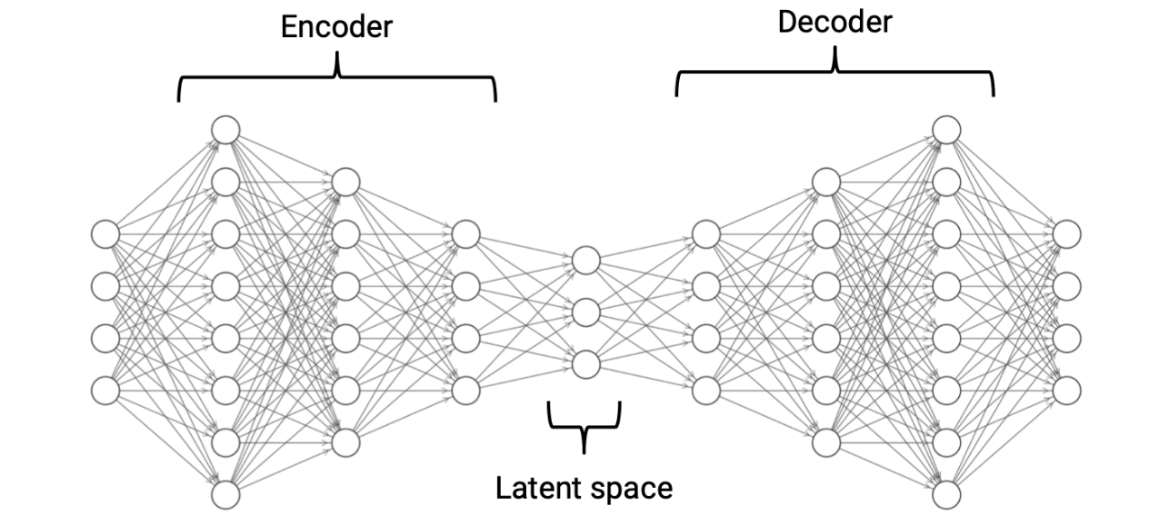
Network Design
An autoencoder consists of two separate networks: the encoder and the decoder. The encoder transforms the input data into a lower-dimensional, compressed representation, while the decoder transforms this representation back into the full-dimensional representation. The point of using an autoencoder to perform compression is that it can learn any function, and can operate quickly once trained.
The basic architecture of the network was taken from the available documentation. The model contains 7 fully-connected layers with 200, 100, 50, 3, 50, 100, 200 nodes and a Tanh activation layer after each layer. The MSE function was used to gauge the accuracy of the recreated data. Two changes were trialled to increase accuracy:
The activation function was varied. Each score is without BN, and using custom scaling:
Tanh: 2.504e-06
LeakyReLU: 5.724e-06
ELU: 1.594e-06
Sigmoid: 5.021e-02
Batch normalization was added between each layer.
Found to decrease validation accuracy.
Image from docs

Slide 6
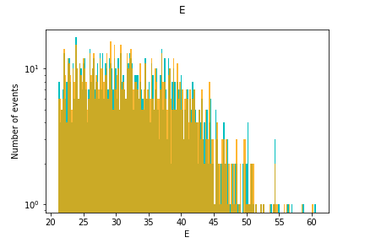
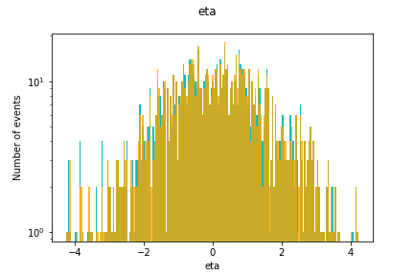
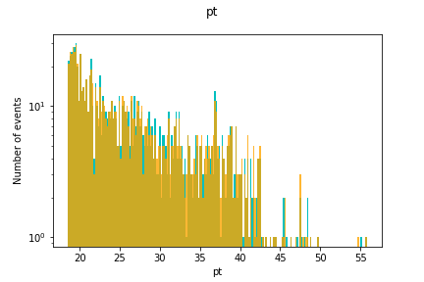
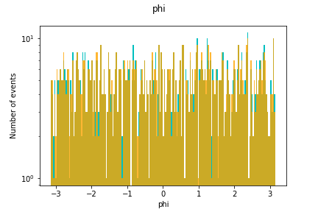
Final Results
The ELU network with no batch-normalization, and custom scaling, was found to produce the best score on the test dataset by a large degree.
MSE Score: 1.594e-06
Custom Normalization
ELU, no BN
Comparison of original and recreated data. Orange is recreated, green is original.

